Slide 1
Analysis of Predictors of Home Prices in Ames, Iowa
August 24, 2018
Naman Bhandari

Slide 2
Background
Question:
Can we identify the metrics that help us best predict the true value of a home in Ames, IA to make good housing investments?
Method:
Analyzed a dataset of homes sold between 2006 and 2010 consisting of various features such as sq. ft. and # of bedrooms
Created a predictive model that results in home price predictions (equation that takes inputs and results in output)

Slide 3
Home prices have been flat from 2005-10 …but number of sales decreased in 2010
Median Sales Price
Number of Sales
Notes:
Presence of university caused jobs to remain strong thus the sales price to remain strong through recession
Also, and strong construction and low available land caused average sales price to remain strong through recession
However, home sales decrease substantially in 2010 indicating that growth in prices was offset by weakening demand, so that when demand rebounds, prices will very likely increase strongly.
Given that backdrop, let’s look at the model we built so we can make good investments today that should pay off in a few years when demand rebounds

Slide 4
What factor(s) are the most important in determining property value?
Location | Home size | Room count
1.
2.
3.
Source: https://www.fortunebuilders.com/what-are-the-biggest-factors-in-determining-property-value/
Notes:
Of the above, location is hard to compare numerically … but home size and room count are comparable

Slide 5
What if we try to predict the price of a home using only living area square feet?
Input: living area square feet (example: 1,000 sq. ft.)
Output: predicted home price (example: $120,000)
Model: y = 120x + 2124
Translation: home’s sq. ft., times 120, plus 2124, is the home’s predicted price
R2 score: 0.46
Translation: only 46% of the variance in home prices are explained by square feet, meaning 54% of the homes’ prices are explained by other variables
Root mean square error: $58,400
Translation: our predictions differ from homes’ true values by $58K (average)

Slide 6
R² = 0.46
RMSE = $58,400
Notes:
Since the amount of variance explained by GrLivArea is only 0.46, there must be other factors that people take into account implicitly but are not easily expressed mathematically. We can do the math and create a model that takes those other features into account, however.

Slide 7
Visualizing features and their correlation with home values

Slide 17
Other features
Certain features that had high correlation with others were dropped from our analysis to avoid “double-counting”
Example: # of cars in garage vs. “Garage Area”

Slide 18
Predictive model with multiple features

Slide 19
Predicting the price of a home using multiple features
Inputs: many (including: sq. ft., rooms, garage size, basement size)
Output: predicted home price (example: $180,000)
Model: y=m₁x₁ + m₂x₂ + . . . + m_{p}x_{p} + B
R2 score: 0.92
Translation: a whopping 92% of the variance in home prices are explained by our model inputs
Root mean square error: $22,723
Translation: our predictions differ from homes’ true values by $22K (average), which is better than our baseline model using only living area square feet

Slide 20
Note: the betas shown represent the change in the home price given a one-standard-deviation sized movement in the feature

Slide 21
Note: the betas shown represent the change in the home price given a one-standard-deviation sized movement in the feature

Slide 22
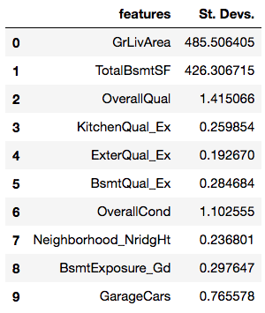
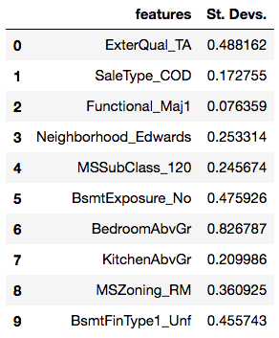
St. devs. of top 10 and bottom 10 features
Top Ten Features St. Devs.
Bottom Ten Features St. Devs.

Slide 23
Further exploration
Use of additional advanced modeling techniques can help us create a more refined model
Continue to minimize root mean squared error (RMSE)
Reduce features to improve interpretability of model
We have an advantage over the most commonly-used, sq. ft.-based model – we can use this to our benefit

Slide 24
Thank you. Questions?

Slide 25
Appendix

Slide 26
R² = 0.46
RMSE = $58,400
$362,124
$242,124
$122,124

